Slide 1
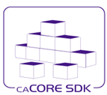
caCORE SDK
Code Generator
Satish Patel

Slide 2
Agenda
caCORE SDK requirements
What is caCORE SDK
What is Data Service
System generation process
Generated system architecture
Security overview

Slide 3
What is Required to Use SDK
Must have working knowledge of
  UML class diagrams
  Enterprise Architect or ArgoUML
  Java
Nice to have knowledge about
  Hibernate
  Web applications
  XML

Slide 4
Required Software
UML Modeling Tool (ArgoUML or Enterprise Architect)
Application Server (JBoss or Tomcat)
Java Development Kit – JDK 1.5
Apache Ant
Internet Explorer
and caCORE SDK

Slide 5
What is caCORE SDK
Framework to generate a Data Services
  Simple tool to build applications for collaborative research environment
  Enables users to quickly build the APIs from UML Model
  Syntactically interoperable APIs (Query via information model)
Integrated security
Built using open source tools and technologies
Seamless integration with cagrid tools

Slide 6

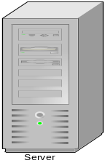
Data Service – What Is It?
A service that allows data owners to share data from a data source (e.g. relational database) with their collaborators
caCORE SDK Generated System
OR
Custom Built Application
Human readable interface (GUI)
Database
Machine readable interface (Java API / Webservice)

Slide 7
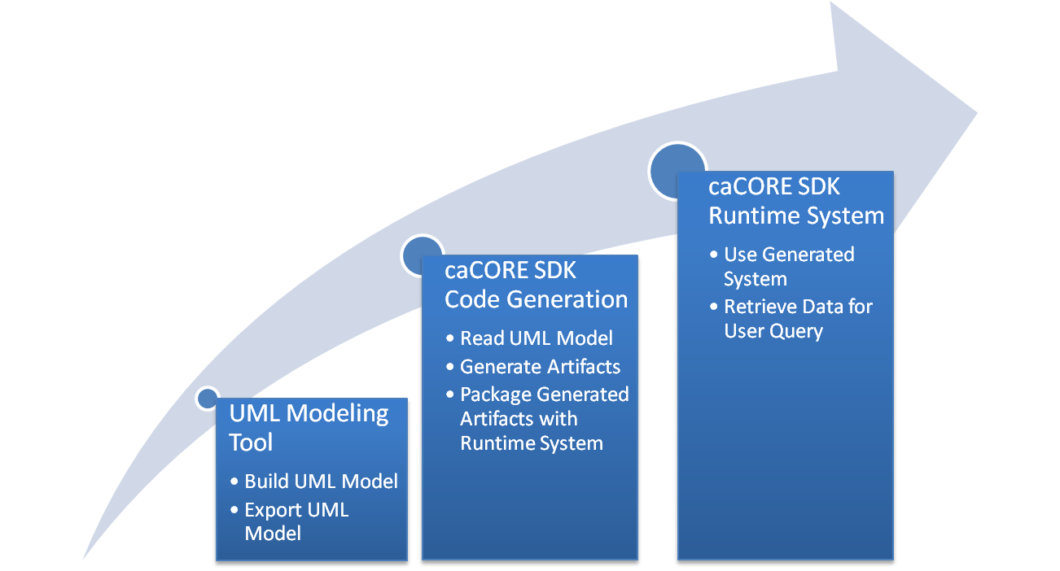
System Generation Process

Slide 8
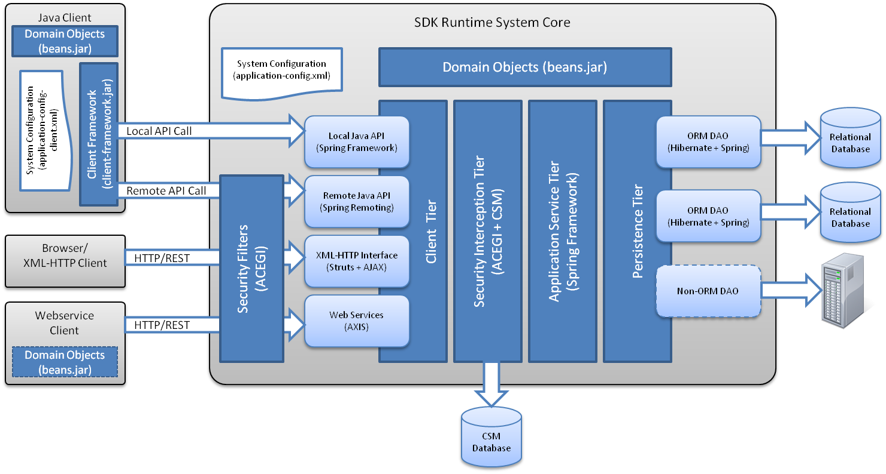
caCORE SDK Architecture

Slide 9
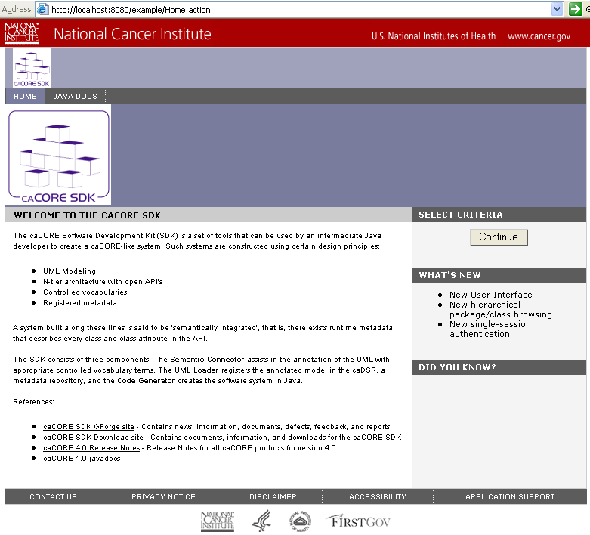
SDK Generated System – HTTP Interface

Slide 10
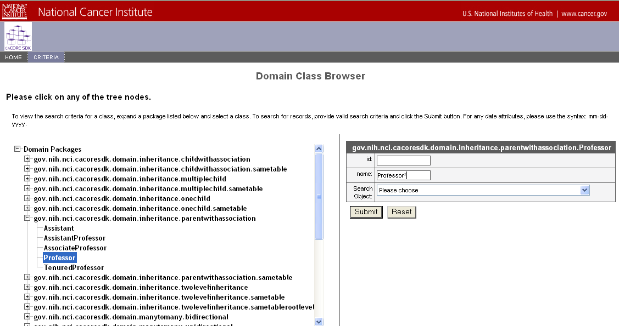
SDK Generated System – HTTP Interface

Slide 11
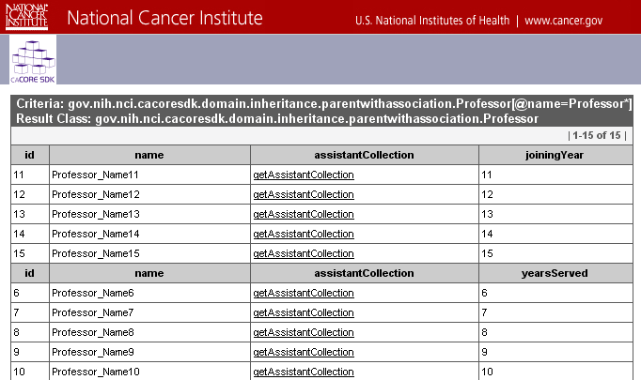
SDK Generated System – HTTP Interface

Slide 12
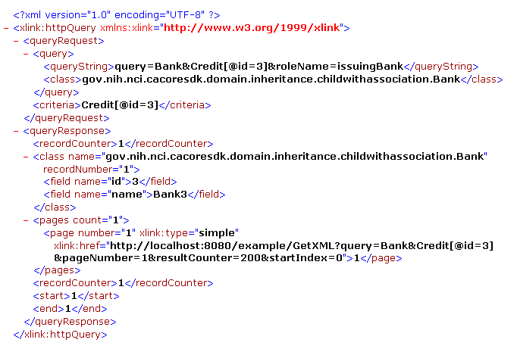
SDK Generated System – XML Interface

Slide 13
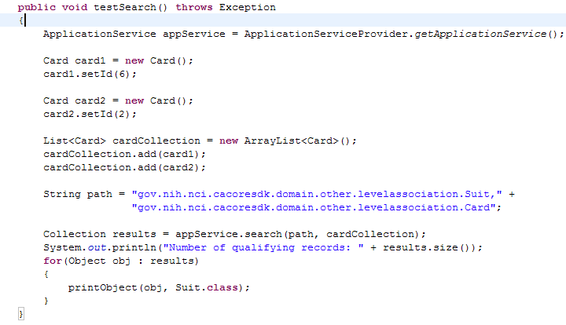
SDK Generated System – Java API

Slide 14
caCORE SDK Security Overview
Common Security Module (CSM) is used for securing SDK
Provides various mechanisms for authentication
  RDBMS
  LDAP
  JAAS
User Provisioning Tool (UPT)
  Web based application to configure authorization schema for security

Slide 15
caCORE SDK Security Overview
Three levels of security provided
Class level security
  E.g. Only investigators can look at data in Patient class
Instance level security
  E.g. Investigators can look at only their patient’s data
Attribute level security
  E.g. Nurses can not see patient’s social security number

Slide 16
Example of SDK Generated Applications
Clinical Trials
  C3PR
  CTOM
  CACTUS
Genomics
  caArray
  caBIO
  caIntegrator
Tisue Banking
  caTissue CORE
Imaging
  NCIA
Infrastructure
  EVS
  caDSR
  UML Project

Slide 17
Questions ???
SDK Users Mailing List
cacore_sdk_users-L@list.nih.gov

Slide 18
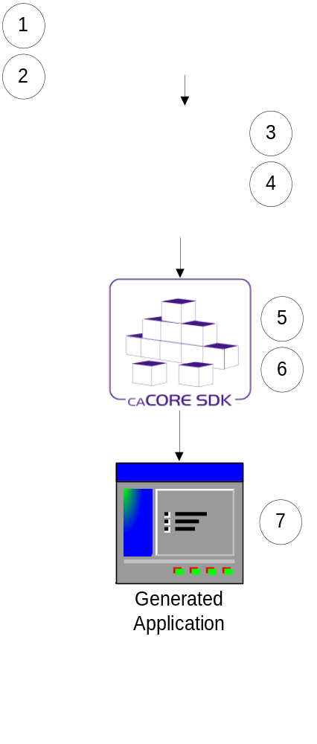
Running the Code Generator
Create Object Model (Enterprise Architect)
Create Data Model (Enterprise Architect)
Perform Object to Table mapping (caAdapter)
Perform Attribute to Column mapping (caAdapter)
Configure the code generator
Run the code generator
Run generated system
Note: Steps 3 to 5 can be performed in Enterprise Architect without using caAdapter.
Assumption: Database is already configured and tables are populated with data

Slide 19
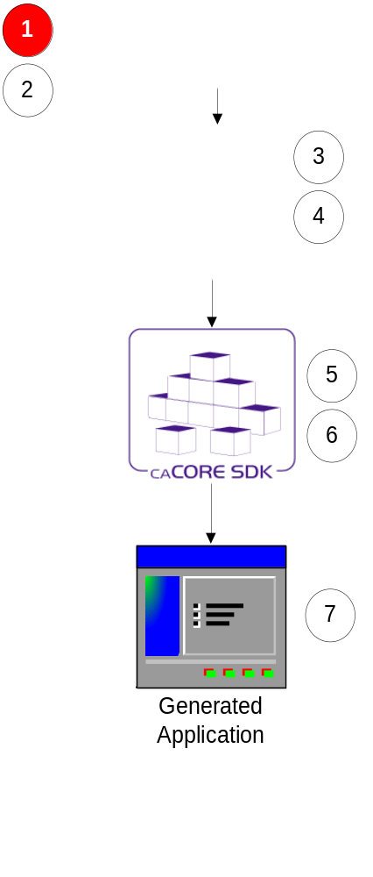
Step 1:
Creating Object Model (Enterprise Architect)
Define classes and its attributes
Define associations between classes
Always follow naming conventions mentioned in programmer’s guide

Slide 20
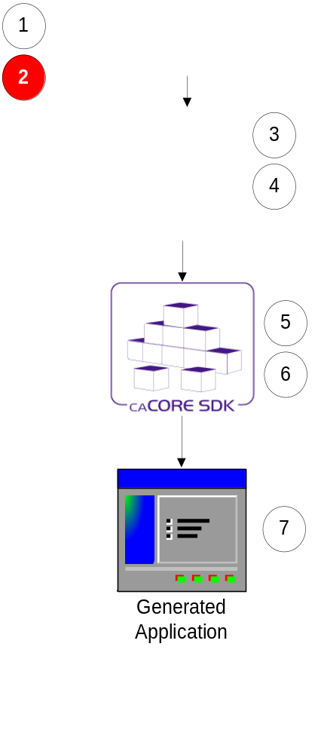
Step 2:
Creating Data Model (Enterprise Architect)
Define tables and its columns
Define primary key and foreign key constraints

Slide 21
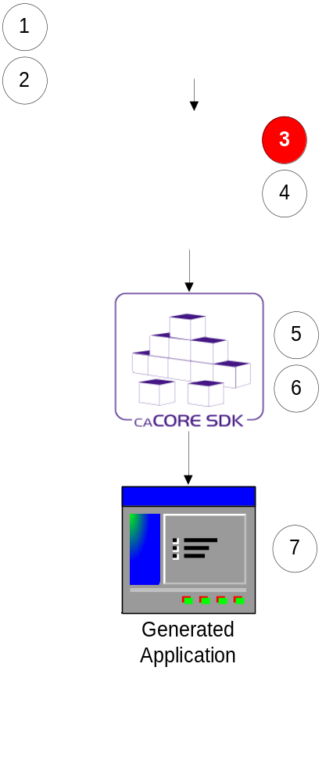
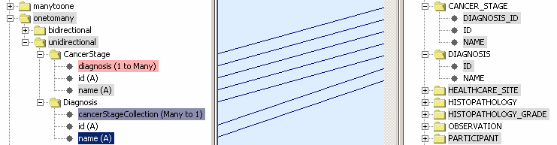
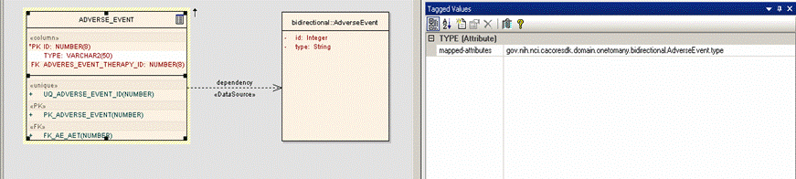
Step 3: Perform Class to Table Mapping
(caAdapter or Enterprise Architect)
Create Dependency link between a Class and a Table

Slide 22
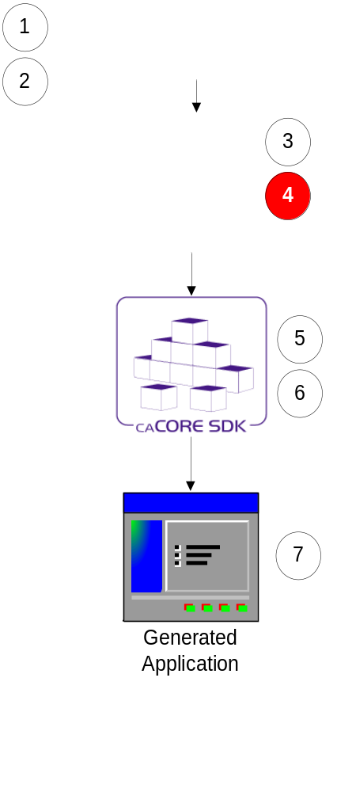
Step 4: Perform Attribute to Column Mapping
(caAdapter or Enterprise Architect)
Create link between a class attribute and table column using a Tag Value

Slide 23
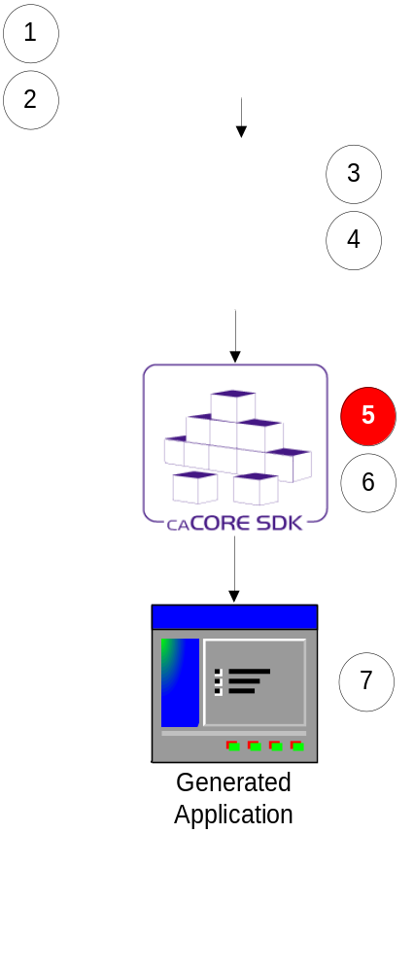
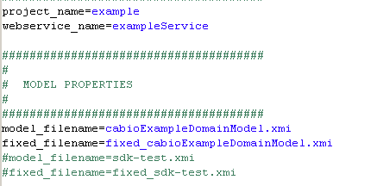
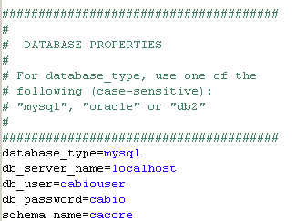
Step 5:
Configure Code Generator
Configuration defined in deploy.properties

Slide 24
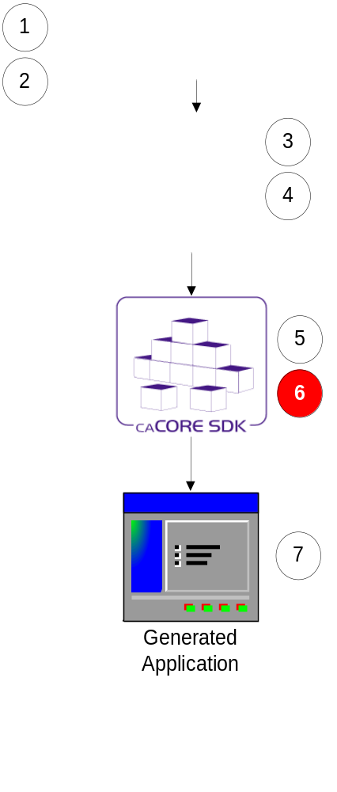
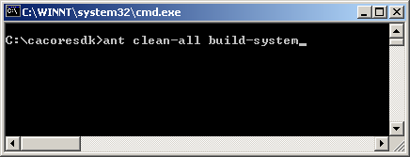
Step 6:
Run Code Generator
Put exported XMI file in caCORE SDK’s models/xmi directory
Go to command window
Execute build-system target

Slide 25
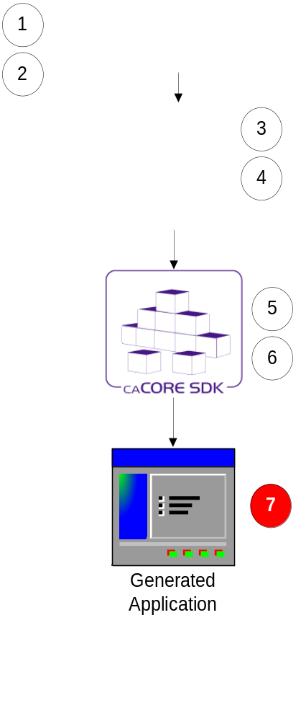
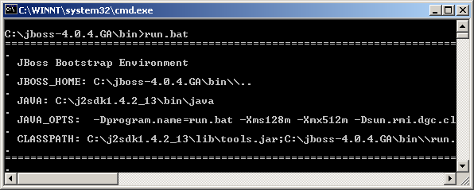
Step 7:
Running Generated System
Start application server

Slide 26
Questions ???
SDK Users Mailing List
cacore_sdk_users-L@list.nih.gov

Slide 27
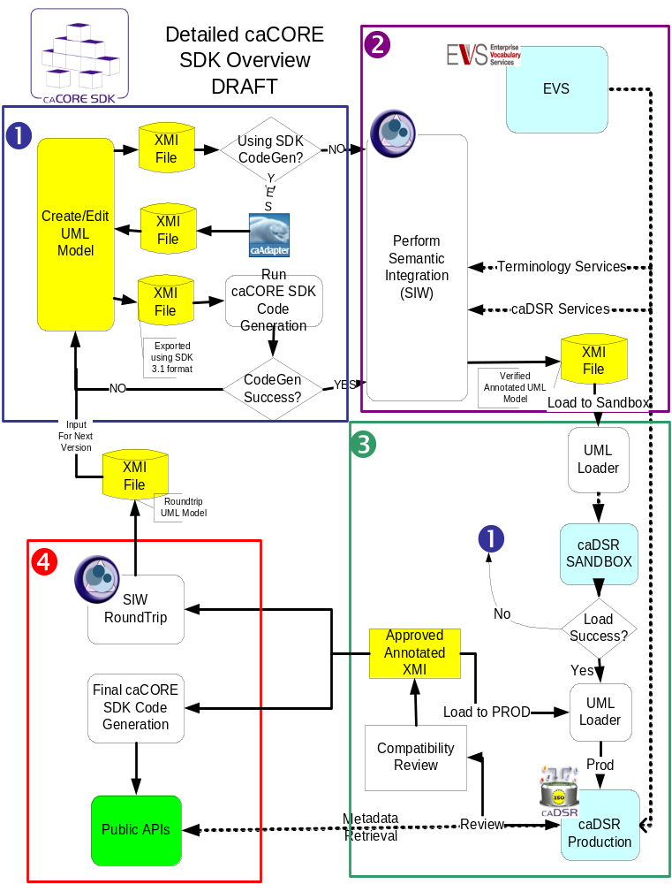
caCORE Process
Design system and draw model
(UML tool)
Annotate model
(Semantic Connector)
Register metadata
(UML Loader)
Generate and deploy system (Code Generator)

